Slide 1
Building network-tolerant PWAs
Now,
Now-Now,
and Just-Now:
@mikegeyser
DevCon Mauritius

Slide 2
Now,
Now-Now,
and Just-Now:
Building network-tolerant PWAs
@mikegeyser

Slide 3


@mikegeyser

Slide 4

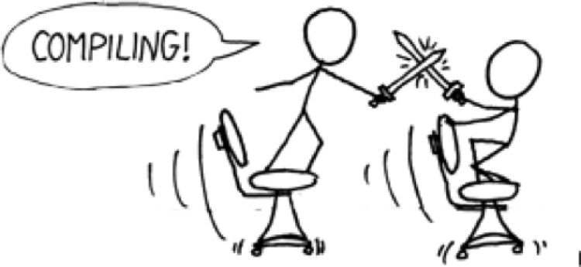
@mikegeyser

Slide 5

@mikegeyser

Slide 6


Slide 7
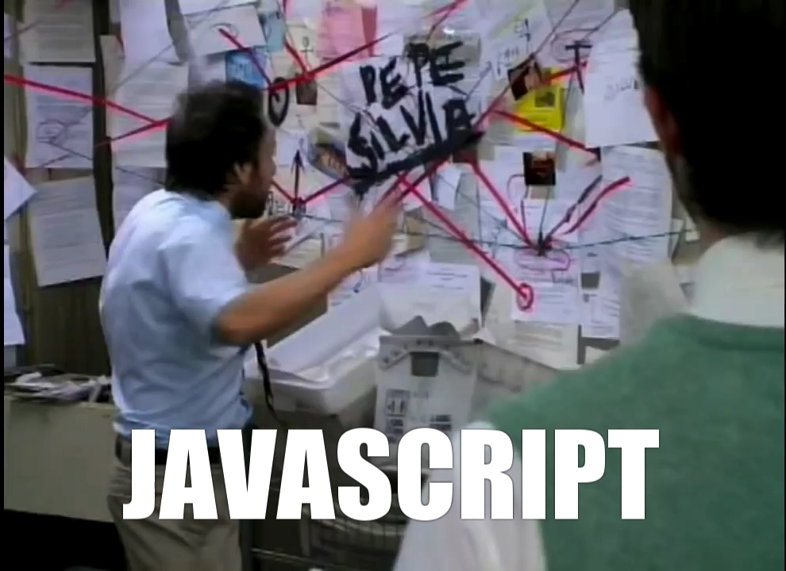

Slide 8

@mikegeyser

Slide 9

Now
Immediately! Probably…
Just-Now
Now-Now
Later?
Maybe…
Soon!
Probably…
@mikegeyser

Slide 10
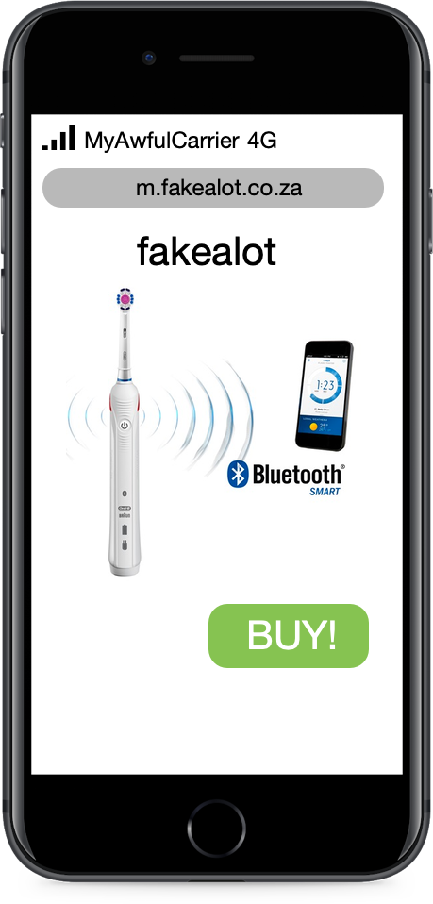

@mikegeyser

Slide 11
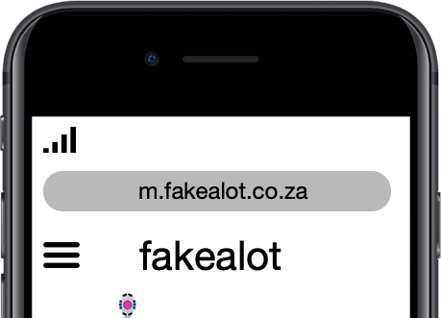
MyAwfulCarrier 4G
@mikegeyser

Slide 12
MyAwfulCarrier 3G
@mikegeyser

Slide 13
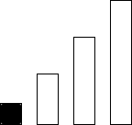
MyAwfulCarrier 3G
@mikegeyser

Slide 14
MyAwfulCarrier Edge
@mikegeyser

Slide 15
@mikegeyser

Slide 16
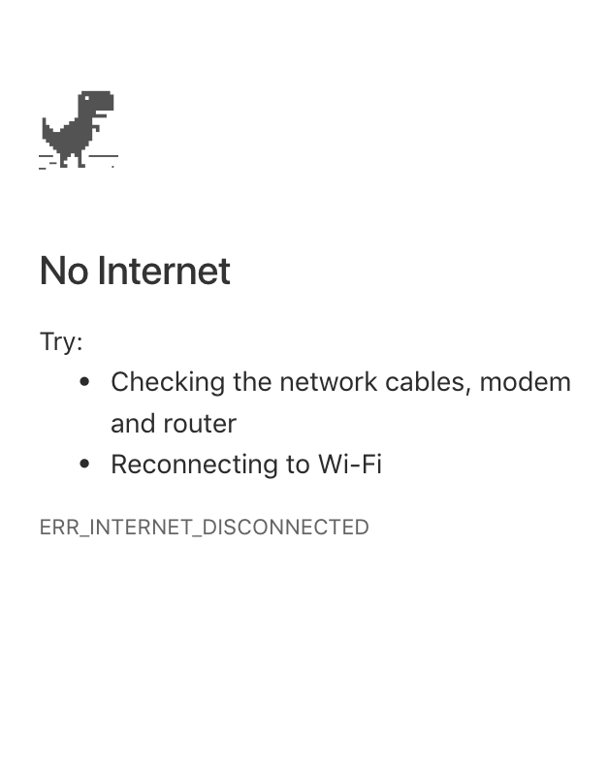
No Service
@mikegeyser

Slide 17

THIS IS WHY
WE CAN’T HAVE NICE THINGS

Slide 18
Network Tolerance
Partition tolerance
Network resilience
‘Offline first’
@mikegeyser

Slide 19
YOU KEEP USING THAT WORD
I DO NOT THINK IT MEANS WHAT
YOU THINK IT MEANS…

Slide 20
So, how do we do this?
@mikegeyser

Slide 21
Communicate state well
@mikegeyser

Slide 22

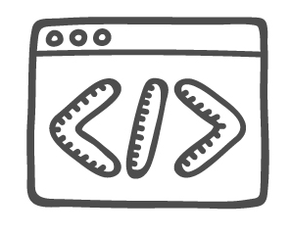

Service Worker
@mikegeyser

Slide 23


Slide 24
IndexedDB
@mikegeyser

Slide 25
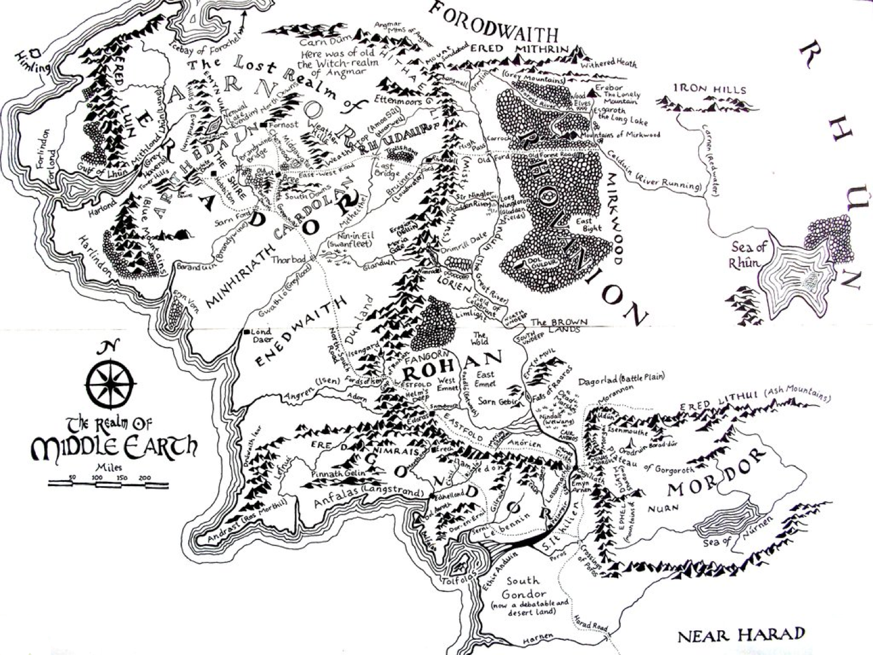

Slide 26

DEMO TIME

Slide 27
Summary
Capabilities
Expectations
Thoughtful design
Plan for offline
@mikegeyser

Slide 28
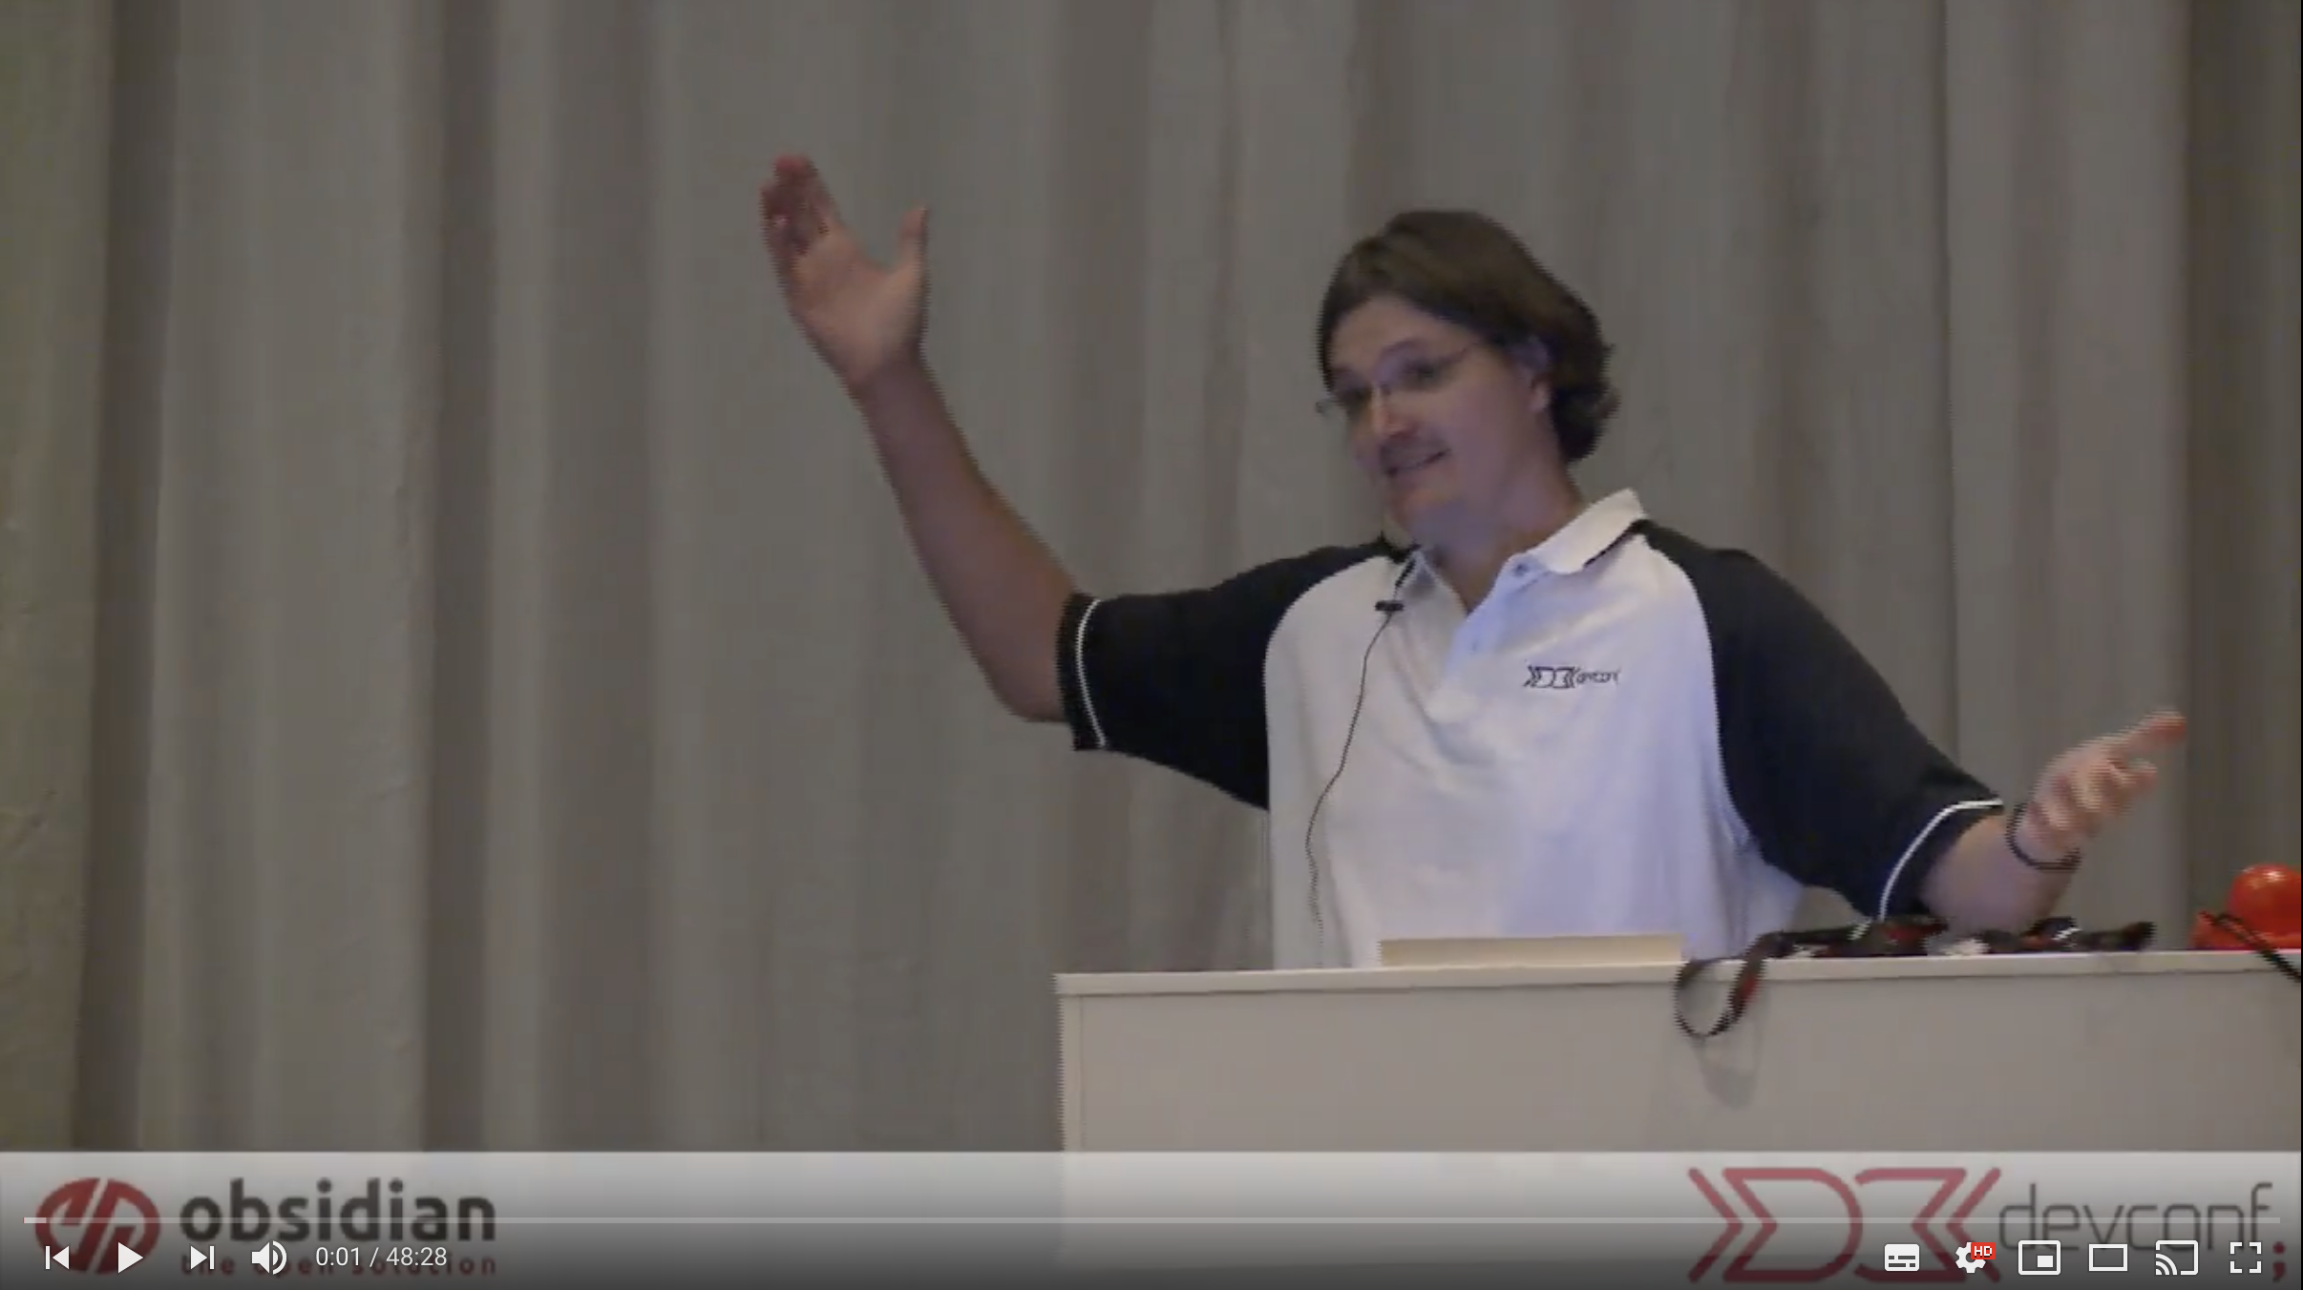
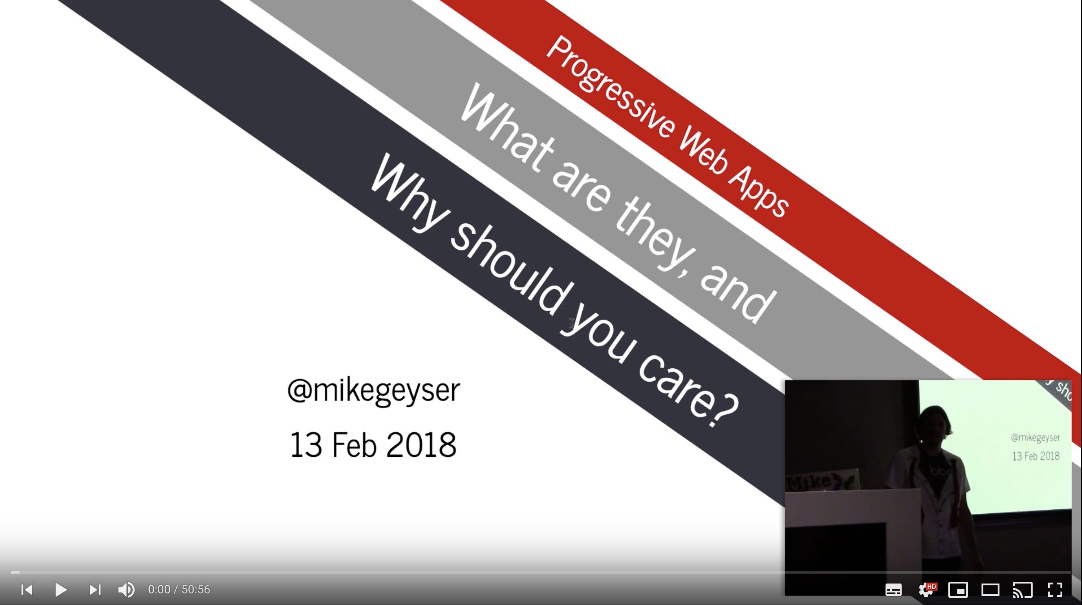
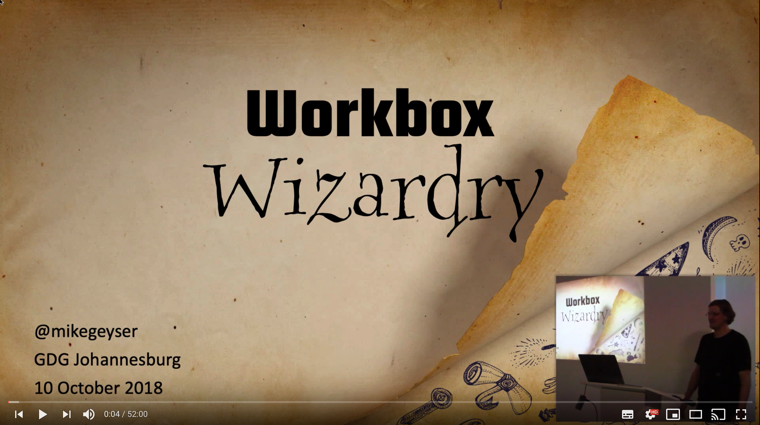
Questions?
@mikegeyser
https://goo.gl/geAwiw

